Slide 1
Home credit score card model
By : Muhammad Julizar

Slide 2
Problem statement
Home Credit seeks to expand their products, with the target is people ho doesn't have bank account with providing a positive and safe money borrowing experience. In order to make this happen Home Credit Create a Machine Learning to predict customers who are able to make repayments are not rejected when applying for a loan.

Slide 3
Table OF CONTENT
PROBLEM STATEMENT
2
EDA
4
DATA PREPROCESSING
7
Model evaluation
8

Slide 4
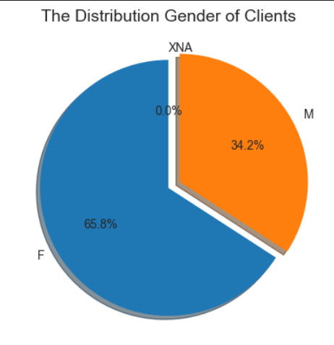
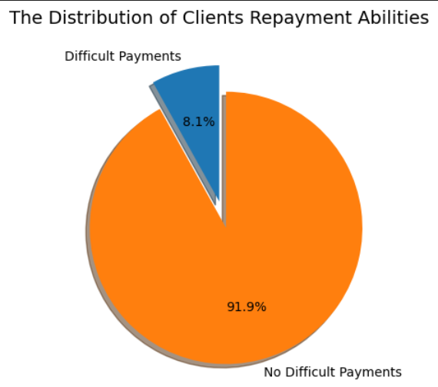
EDA (EXPLORATORY DATA ANALYSIS)
Gender of Client
Payment Ability
The client was dominated by Female with 65.8% than Male just 34.2%
Almost of the client have no difficult payments with 91.9%

Slide 5
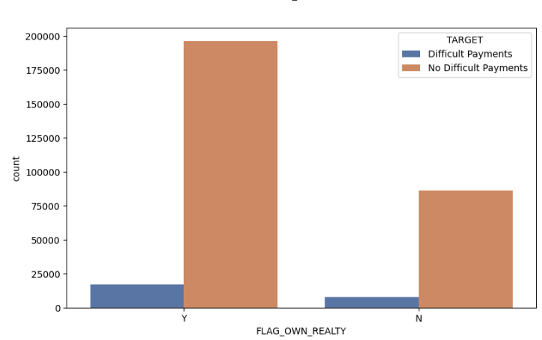
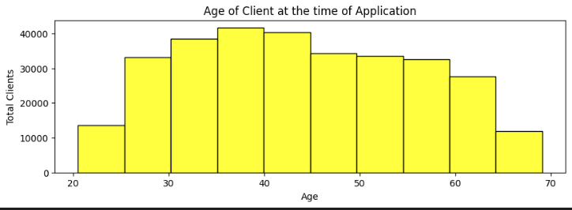
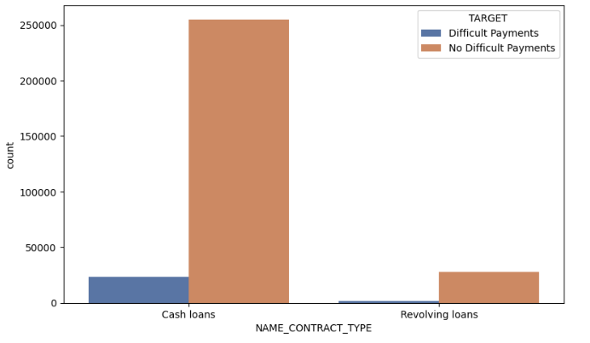
Characteristic of client
The majority of loan applicants fall within the age range of 35-45 years, with the next highest number of applicants being in the 40-45 age range. On the other hand, there is a significantly low number of applicants below the age of 25 or above 65.
clients who own realty make more loans than those who do not own realty.
The contract is dominated by Cash loans

Slide 6
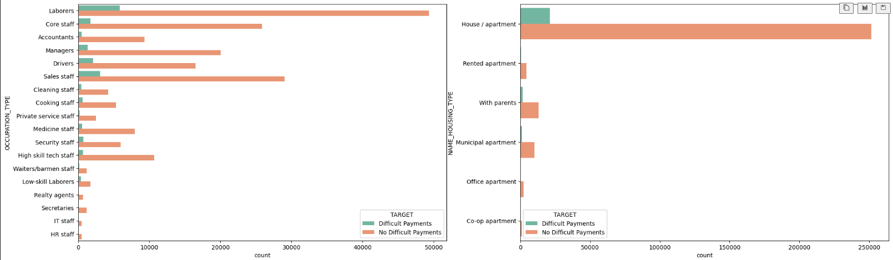
PRODUCT BENEFITS
- The top 5 job types that borrow the most are Laborers, Sales Staff, Core staff, Managers and Drivers.
- Clients who live in a house/apartment make loans more often than others

Slide 7
Data preprocessing
121 columns
48,744 Rows
Check Duplicates
0 Duplicates
Scalling and Encoding
PREDICTION
RAW DATA
Handling Missing Values
Resampling
Handling Outlier
Feature Selection
From 121 to 50 Features

Slide 8
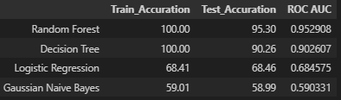
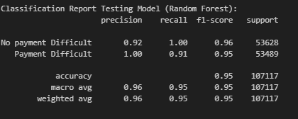
Model evaluation
From the above metrics values and classification report testing Random Forest is the best algorithm model compared to the other 3 algorithms with a test Accuracy value of 95.30% and a ROC AUC value of 0.952.
In addition, if seen from the classification report value, the Precision value of random forest is 0.92 and the Recall value is 0.91, this shows that the model is very good at predicting class 0: No difficult Payment and class 1: Difficult Payment

Slide 9
Conclusion
Random Forest Algorithm is the best algorithm model among Logistic Regression, Gaussian Naive Bayes and Decision Tree that can be used to predict customers who are able to make repayments so that they are not rejected when applying for a loan.
Random Forest is the best algorithm model with a test Accuracy value of 95.30% and a ROC AUC value of 0.952. which means from a total of 48609 people who have no difficult payment in `application_test` we only have a risk of misprediction of 4.7% prediction error which is very good if the machine learning is implemented.
Business Recommendation
By looking at the data, the characteristics of clients who make more loans with `no difficult payment` are clients between 35-45 years old, have a place to live, have higher education, have a job, and are married, we can create more campaigns with these characteristics.
From this historical data, companies consider offering various types of loans that suit customer needs and preferences. For example, personal loans, business loans, or property loans. By providing a variety of options, the company can reach a wider market segment and cater to the needs of diverse customers.

Slide 10
THANK YOU
Mirjam Nilsson​
206-555-0146
mirjam@contoso.com
www.contoso.com

